Slide 1
Web-development
Basics

Slide 2


Slide 3


Slide 4
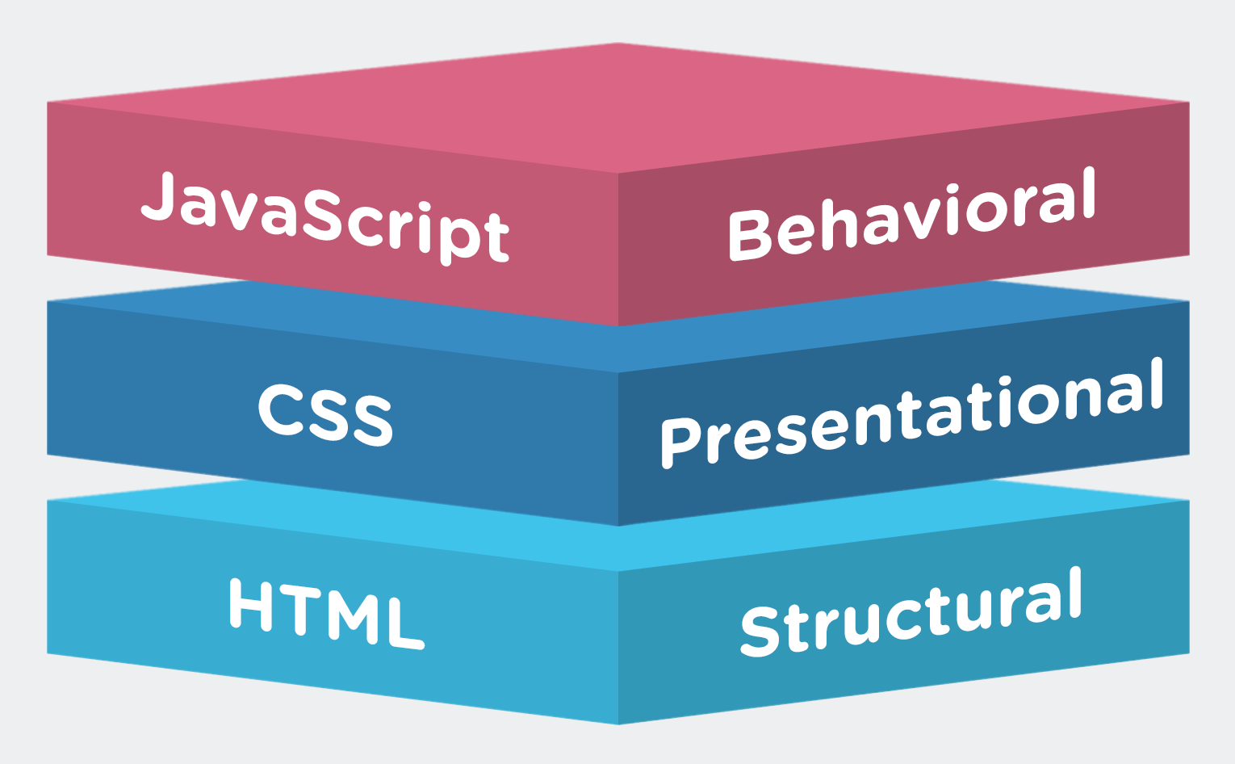
Building Chat Bot
Kabeer

Slide 5


Slide 6
Agenda
Website- Basics
Html
Css3
Jquery
Bootstrap
Static web site
Dynamic site -Wordpress

Slide 7
HTML
HTML introduction

Slide 8
Html - Basic tags -sheet
Head
Header ,footer
body
paragraphs
Bold ,strong content
h1-h6
Link tags - <a> -
Adding images
Order list .un-ordered list
Iframe -content loading - <iframe src="URL"></iframe>

Slide 9
Images
<img src="image.jpg" alt="my image">

Slide 10
Html - Basic tags
Video
<video width="400" controls>
<source src="video.mp4" type="video/mp4">
</video>
Audio
<audio controls>
<source src="filename.mp3" type="audio/mpeg">
</audio>

Slide 11
Embed youtube
<iframe width="854" height="480" src="https://www.youtube.com/embed/IRFcVvahCWQ" ></iframe>

Slide 12
Get User input -text
Text Inputs
-------------
<input name="firstname" type="text">

Slide 13
Drop Downs
<select name="names">
<option value="user1">user1</option>
<option value="user2">user2</option>
</select>

Slide 14
Text-area & email
<textarea name="message" >A huge message </textarea>

Slide 15
Buttons & Range
<button type="button" >i am a button</button>
<input type="range" >

Slide 16
Date & password
<input type="date" >
<input type="password" >

Slide 18
CSS

Slide 19
What id and class & Selectors?

Slide 20
Inernal Style sheets
Internal :
<style>
body {
background-color: red;
}
</style>

Slide 21
External
<head>
<link rel="stylesheet" type="text/css" href="style.css">
</head>

Slide 22
Important css properties

Slide 23
Chat Bot -Node Basics
width/height
box model
text-align
Disply type
Postions
float
shadows
color
background-color
background-image: url("test.png");
Borders
Margin
padding

Slide 24
Shadows
Text shadows :
h1 {
color: white;
text-shadow: 2px 2px 4px #000000;
}

Slide 25
Box-Shadows
div {
width: 300px;
height: 100px;
padding: 15px;
background-color: red;
box-shadow: 10px 10px;
}

Slide 26
Jquery
Why Jquery ?

Slide 27
Installing Jquery
<head>
<script src="jquery-3.3.1.min.js"></script>
</head>
Or
<head>
<script src="https://ajax.googleapis.com/ajax/libs/jquery/3.3.1/jquery.min.js"></script>
</head>

Slide 28
Short test
$(document).ready(function(){
alert(“jquery added”)
});

Slide 29
Basic functions
$(document).ready(function(){
$("button").click(function(){
$(“.hide").hide();
});
});

Slide 30
Jquery Events
Click
load/ready
mouseenter/mouseleave
Change,focus,blur
keypress

Slide 31
Testing Events
$(document).ready(function(){
$("p").click(function(){
$(this).hide();
});
});

Slide 32
Properties
$(document).ready(function(){
$("p").click(function(){
$(this).hide();
});
});

Slide 33
Fade

Slide 34
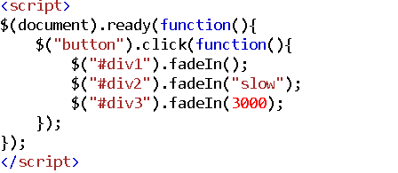

Slide 35
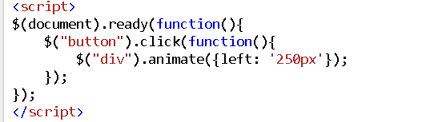
Animate

Slide 36
Add Class & remove

Slide 37
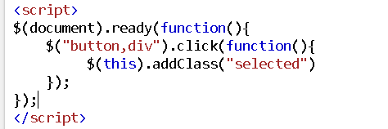

Slide 38
Jquery Appending Values

Slide 39
Append Example

Slide 40
Bootstrap

Slide 41
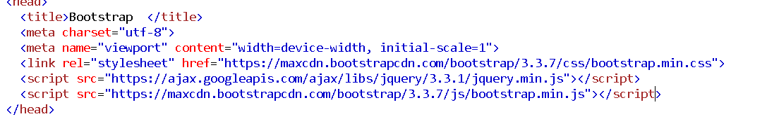
Installation

Slide 42
Container vs Container fluid

Slide 43
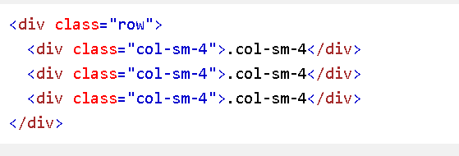
Bootstrap grids

Slide 44
Bootstrap tables

Slide 45
Gallary

Slide 46
Alerts

Slide 47
Modals
Filters
Sliders
Collapse

Slide 48
Full theme

Slide 49
Dynamic Wordpress

Slide 50
Thank You
kabeeraamiri@gmail.com
+91-9003039766

